Slide 1



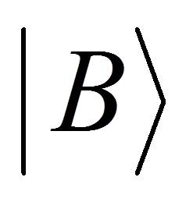
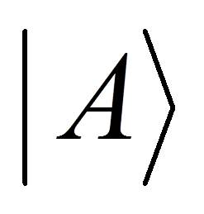
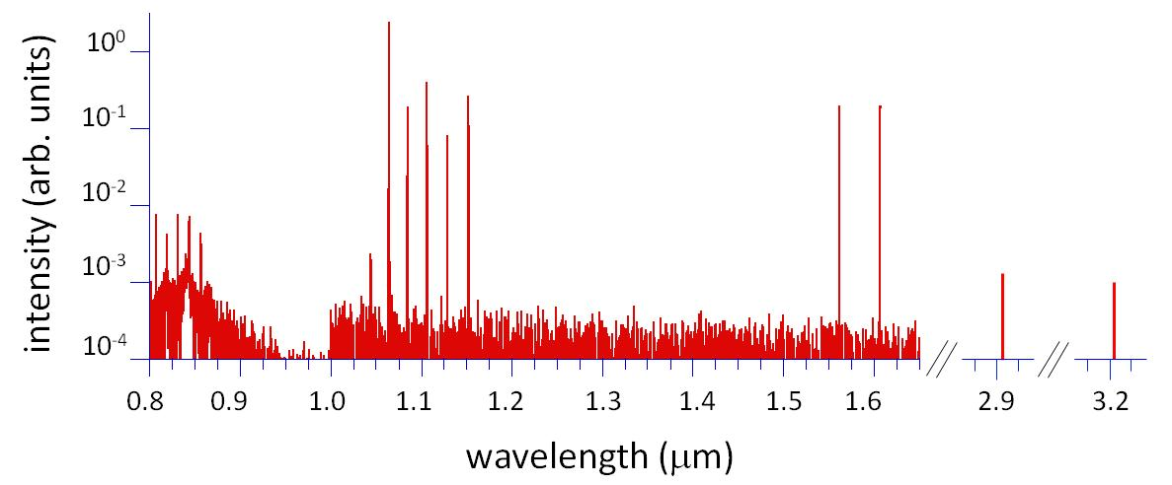
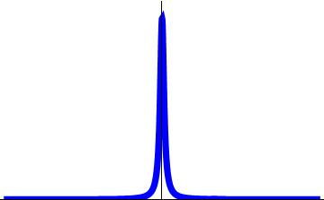
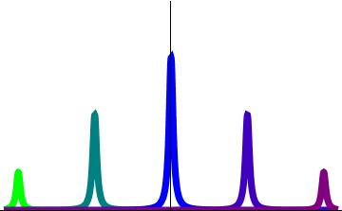
Broadband Spectrum Generation Using
Continuous-Wave Raman Scattering
J. J. Weber, D. C. Gold, and D. D. Yavuz
University of Wisconsin - Madison
Optical Modulator
Molecular Modulation
Previous Work:
Two Octave Spectrum
Mixing Beam
With this method of molecular modulation, we can modulate any independent mixing beam. As the beam need not be resonant with the cavity, this technique provides a simple way to increase the span and number of components in the produced spectrum. Tuning of the cavity length and pump beam allows different vibrational and rotational sidebands of the mixing beam to be produced. We will soon add an independent Stokes beam, which will greatly increase conversion efficiency.
We have constructed a broadband optical modulator with modulation frequencies of up to 89 THz. Our modulator is based on continuous-wave stimulated Raman scattering with molecular deuterium inside a high-finesse cavity.
As the incident high-intensity pump laser resonates in the cavity, it scatters off of the deuterium molecules and drives a two-photon, ro-vibrational transition. Through Raman lasing, a lower frequency Stokes beam is generated from noise. The resonant pump and Stokes lasers build up a molecular coherence between the states.
Using this molecular modulation technique with only the Raman pump beam, we have generated a spectrum spanning two octaves of optical bandwidth. This spectrum is produced through Raman scattering off of one rotational and one vibrational transition and contains 15 components, spanning from around 0.8 μm to 3.2 μm, or 94 THz to 375 THz.
ν_{Raman pump}
ν_{Raman Stokes}
ν₀ + 2ν_{m}
ν₀ + ν_{m}
ν₀
ν₀
hν_{m}
Theoretical conversion efficiencies of mixing to sideband beam powers for different pressures of H₂ ; the solid red is 0.33 atm, and the dashed green is 0.08 atm. We expect that the conversion efficiency curve for the current experiments with D₂ will be qualitatively similar.
ν₀- ν_{m}
10⁻⁴
ν₀ - 2ν_{m}
This molecular coherence can then be used to modulate a mixing laser. The generated beams are shifted up or down in frequency by ν_{m}, the modulation frequency, which is set by the ro-vibrational Raman transition.
Vibrational
Anti-Stokes Group
Pump Group
Vibrational Stokes Group
10⁻⁵
Second Order Vibrational Stokes Group
10⁻⁶
Conversion Efficiency
Intensity
Intensity
10⁻⁷
ν_{anti-Stokes}
10⁻⁸
ν_{mixing}
0.1
1
10
ν_{mixing}
ν_{Stokes}
Wavelength (μm)
Previously generated spectrum from molecular modulation of a 1.06 µm Raman pump beam. The number and relative intensity of components can be somewhat tuned by adjusting the cavity and Raman pump beam.
Frequency
hν_{m}
hν_{m}
After establishing molecular coherence using the Raman pump beam, we have successfully modulated an independent 780 nm mixing beam by 89 THz. We have qualitatively observed the resulting 633 nm anti-Stokes beam.
|
Experiment
1064nm ECDL
– Raman Pump
DM
Dichroic Mirror
ECDL
External Cavity Diode Laser
EOM
Electro-Optic Modulator
FA
Fiber Amplifier
GS
Glass Slide
HFC
High-Finesse Cavity
MML
Mode-Matching Lens
PD
Photodiode
TA
Tapered Amplifier
Yb FA
780nm ECDL
– Mixing Beam
A 1064 nm external cavity diode laser (ECDL) is amplified with an ytterbium fiber amplifier (FA). The resulting 20 W beam is locked to a D₂-filled high-finesse optical cavity (finesse ~ 20,000) via a Pound–Drever-Hall (PDH) locking circuit. This beam serves as the Raman pump beam. The Raman Stokes beam at 1555 nm (not shown) is generated through Raman lasing, which is also resonant with the cavity and together with the pump beam builds up molecular coherence. A second 780nm ECDL then generates an independent mixing beam, which is not resonant with the cavity, and is modulated by 89 THz in one pass to produce a 633 nm sideband.
EOM
TA
We plan to eventually modulate the already broad output of a Ti:sapphire laser. The resulting spectrum would span the full optical region and would contain a few million CW Fourier components. Such a broad, coherent spectrum could be used to generate arbitrary optical waveforms with sub-femtosecond resolution.
D₂-Filled HFC
Initial Ti:sapphire Spectrum
GS
DM
MML
MML
First Order Sidebands
Intensity (arb. units)
Second Order Sidebands
PD
Prism
A simplified diagram of the experimental setup. A portion of any mixing beam will be modulated by 89 THz when passing through the cavity. We have qualitatively observed the 633 anti-Stokes beam from a 780nm mixing beam.
Third Order Sidebands
To Locking Circuit
633nm
– Sideband
Wavelength (μm)
To
Detector
This work was funded by the NSF and UW-Madison

