Slide 1
GEANT 4
December 13th, 2012
Slide: 1
An Introduction to Computer Simulations of Muography
By: Daniel Howard

Slide 2
What is GEANT 4?
December 13th, 2012
Slide: 2
Programmable environment to simulate muons and high energy particles passing through various types of detectors of various shapes.
By: Daniel Howard

Slide 3
Current Release
December 13th, 2012
Slide: 3
Current Release: 9.5
Released as source code, no GUI.
Requires advanced technical programming knowledge (C/C++)
Preconfigured libraries built on:
Linux (Scientific Linux CERN 5 or SLC5 based off RedHat Linux)
Windows 7 with Visual Studio C++
MAC OSX 10.7 with gcc-4.2.1
See release notes at: http://geant4.cern.ch/support/ReleaseNotes4.9.5.html
By: Daniel Howard

Slide 4
Required Software
December 13th, 2012
Slide: 4
Currently installed on WI HEP cluster
Individual Use
GEANT4 Toolkit http://geant4.web.cern.ch/geant4/support/download.shtml
C++ Compiler: Visual Studio 2010 (recommended) or Eclipse IDE
Students/Staff can create a Microsoft Dreamspark account.
Visual Studio 2010 Professional (recommended) is free as well as other software.
CMake 2.6.4 or higher
Linux/Mac options also available, see Installation Guide http://geant4.web.cern.ch/geant4/UserDocumentation/UsersGuides/InstallationGuide/html/
By: Daniel Howard

Slide 5
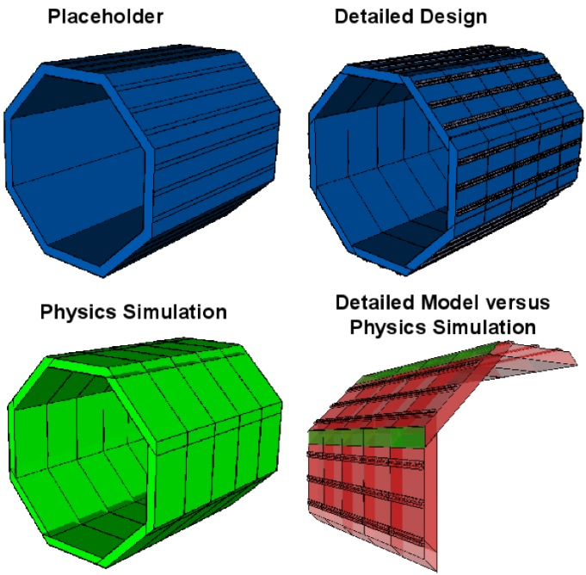
Configuration
December 13th, 2012
Slide: 5
The user supplies the geometry, the list of physics processes, the initial states
GEANT4 supplies the information about particles passing through user-defined inspection points called detectors.
Should be done with object-oriented programming
For other suggestions, see: http://accms04.physik.rwth-aachen.de/~hgast/cplusplus/vortrag_day5.pdf
By: Daniel Howard

Slide 6
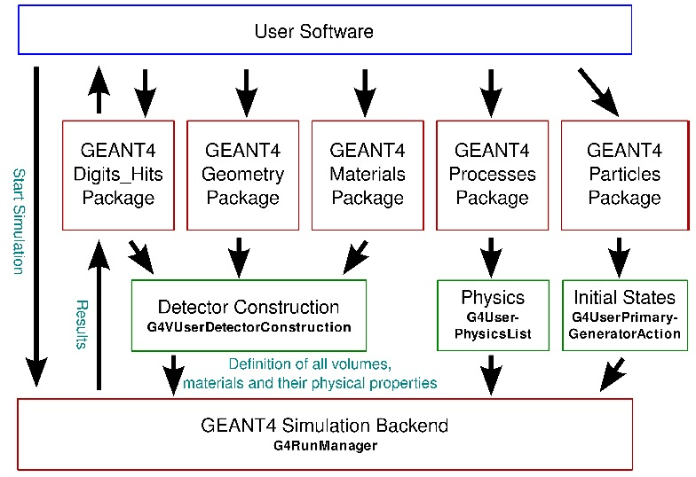
Computer Process
December 13th, 2012
Slide: 6
Remember only computer simulation, not "scientifically" valid.
Good for educational purposes only.
Get what you put into it.
By: Daniel Howard

Slide 7
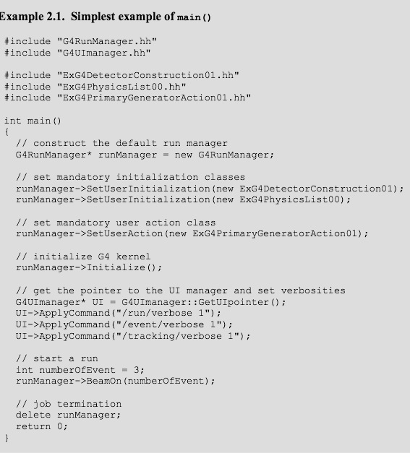
Sample main() Method
December 13th, 2012
Slide: 7
Note to self: Need to learn more C/C++ over break.
By: Daniel Howard

Slide 8
Citations
December 13th, 2012
Slide: 8
1. GEANT4 Introductory Course
2. GEANT4 Official Installation Guide
3. GEANT4 Official Application Developer Guide
4. Example Utility of GEANT - Scholarly Article
By: Daniel Howard

